Slide 1

ANALYTICAL CRM DEVELOPMENT FOR A BANK
Data ANALYSIS REPORT
PRESENTED BY: VAISHALI PANSE

Slide 2
INTRODUCTION
Data ANALYSIS REPORT
Here we are going to discuss the customer relationship management analysis report for the bank which is located at different geographic locations.

Slide 3
Geographic Locations
Data ANALYSIS REPORT
2509
2477
5014
Germany
SPAIN
FRANCE
Germany is the region which has second largest customers
Spain is the region having smallest count of customers
France is the region which has highest customers

Slide 4


GENDER Distribution
MALE
Female
Data ANALYSIS REPORT
Male has 2867 active accounts.
Female has 2284 active accounts.

Slide 5
AGE Category
18-30
50+
30-50
Data ANALYSIS Report
There are 1641 customers belong to
18-30
There are 1395 customers above 50.
There are 7000 customers belong to
30-50 which consist of highest customer count.

Slide 6
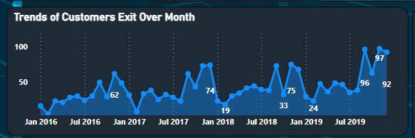
Now entering into the part of churn
Data ANALYSIS Report
From this chart, We can understand that end of every year has highest rate of churn
And also, In the month January and February there seems to be lesser churn.

Slide 7
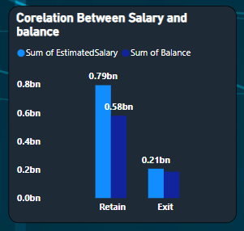
Data ANALYSIS Report
Cause:
From this chart, We get to know that the customers who is having low salary and having low balance plan to leave the bank.

Slide 8
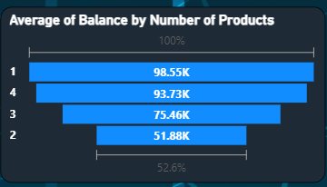
Another Cause
Data ANALYSIS Report
The person who are buying 4 products or 1 products are exiting the bank.
This could be resolved by offering a way that the customers who buys products should buy Minimum of 1 product and also maximum of 4 products

Slide 9
Credit Card holders
Data ANALYSIS REPORT
ACTIVE
1549 customers
Credit card Holders
Retain
There are 2180 customer retained in the bank
There are 2434 Customers having credit cards.
Not ACTIVE
1349 customers
ACTIVE
409 customers
EXIT
There are 925 customers exits the bank.
NOT ACTIVE
695 customers

Slide 10
CREDIT SCORE worthiness
Data ANALYSIS REPORT
CREDIT SCORE RANGE | CREDIT WORTHINESS | CUSTOMERs COUNT
350-450 | POOR | 61
450-550 | FAIR | 307
550-650 | GOOD | 689
650-750 | VERY GOOD | 667
750-850 | EXCELLENT | 313

Slide 11
YEAR WISE CHURN RATE
Data ANALYSIS REPORT
2016
2017
376 customers have exited in the year 2016
479 accounts are exited
2018
2019
In the year 2018, 524 accounts have been churned
We are facing highest churn rate as 658 accounts in the current year

Slide 12
99086.13
100970.14
101912.67
Data ANALYSIS REPORT
YEAR 2019 AVERAGE ESTIMATED SALARY
YEAR 2018 AVERAGE ESTIMATED SALARY
YEAR 2017 AVERAGE ESTIMATED SALARY

Slide 13
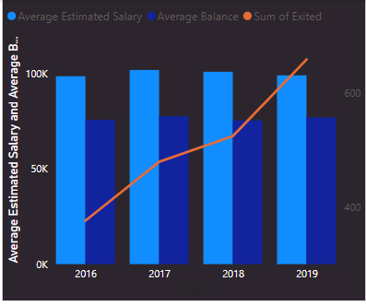
RISK ANALYSIS
Data ANALYSIS REport
we can identify that there is dip in average salary of customers from the year 2016 to 2019. With the correlation of decreasing average salary, the churn rate seems to be increasing.
On the other hand, with respect to salary, balance also get decreased. So that their credit score range or credit worthiness will automatically gets decreased.

Slide 14
Data ANALYSIS REPORT
Conclusion
bank CRM is an scientific approach for building and sustaining long term business with customers to satisfying them. It is focused on improvement and enhancement of business processes
Benefits of CRM implementation in Banking:
Customer satisfaction
Customer focus and retention
Improve customer service
Understand customer value
Better relationship marketing
Benefits for employees

Slide 15
Data ANALYSIS REPORT
Customer relationship Management plays a vital role for competition in the banking industries.
Solution-
By increasing the tenure period for the customers who is having low salary, Customers could able to stay in the bank.

Slide 16
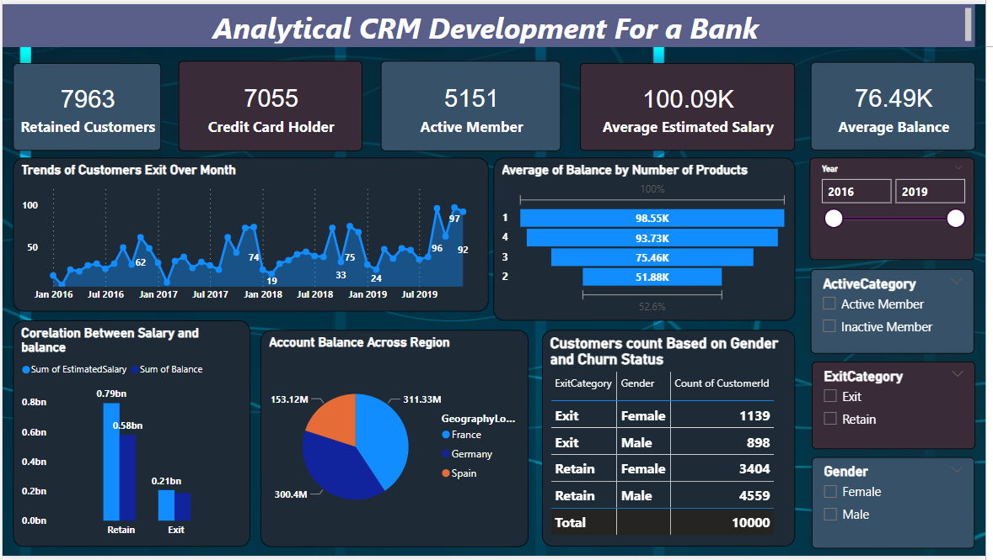
Dashboard
Data ANALYSIS REPORT
This is the report, I have created to analyze Customer Relationship Management

Slide 17
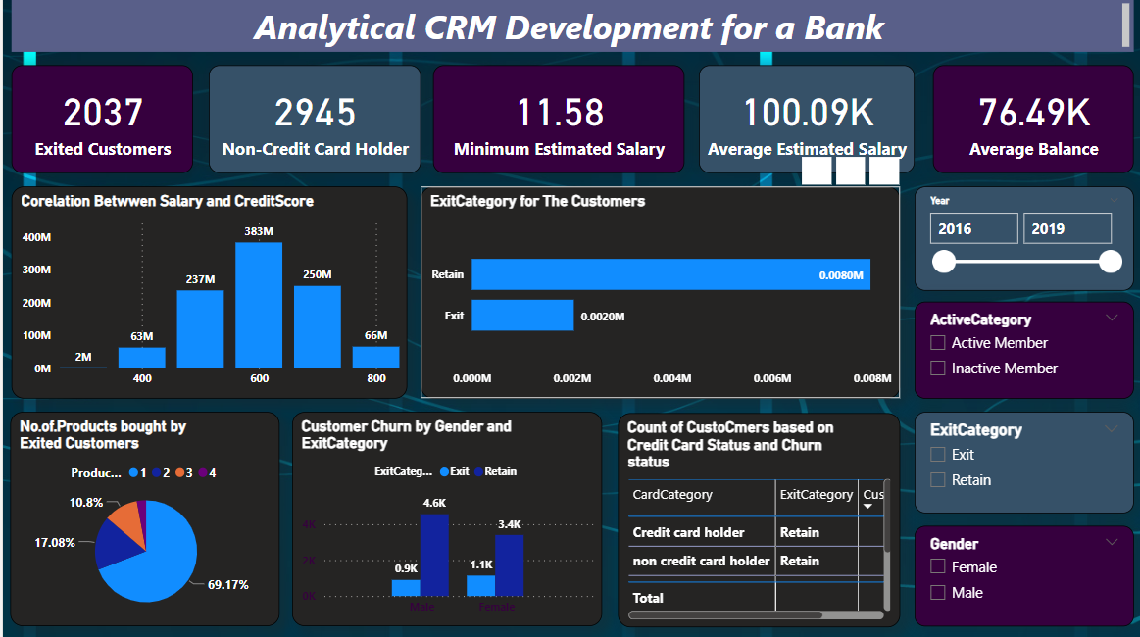
Dashboard 2
Data ANALYSIS REPORT

Slide 18
THANK YOU

